Slide 1
What’s cooking?
Predicting cuisine given a list of ingredients
Allison | Chico | Christian

Slide 2
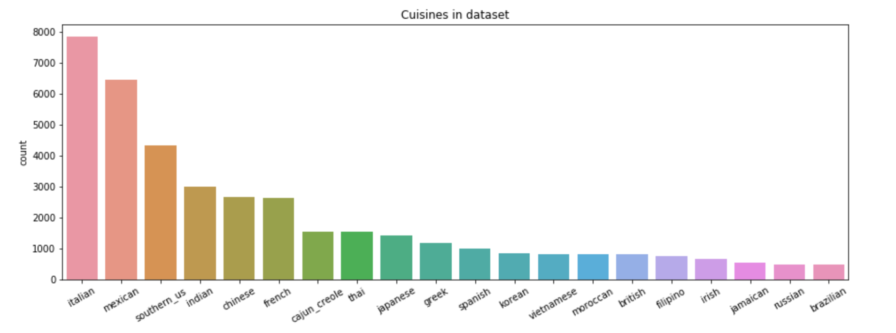
The data
Kaggle Kernel
39,774 recipes
20 cuisines
6,714 unique ingredients

Slide 3
The strategy
Data cleaning
Extensive EDA
NLP
Tf-Idf
Ingredient categorization
Machine Learning
Logistic Regression
Support Vector Machines
Random Forest
Naive Bayes

Slide 4
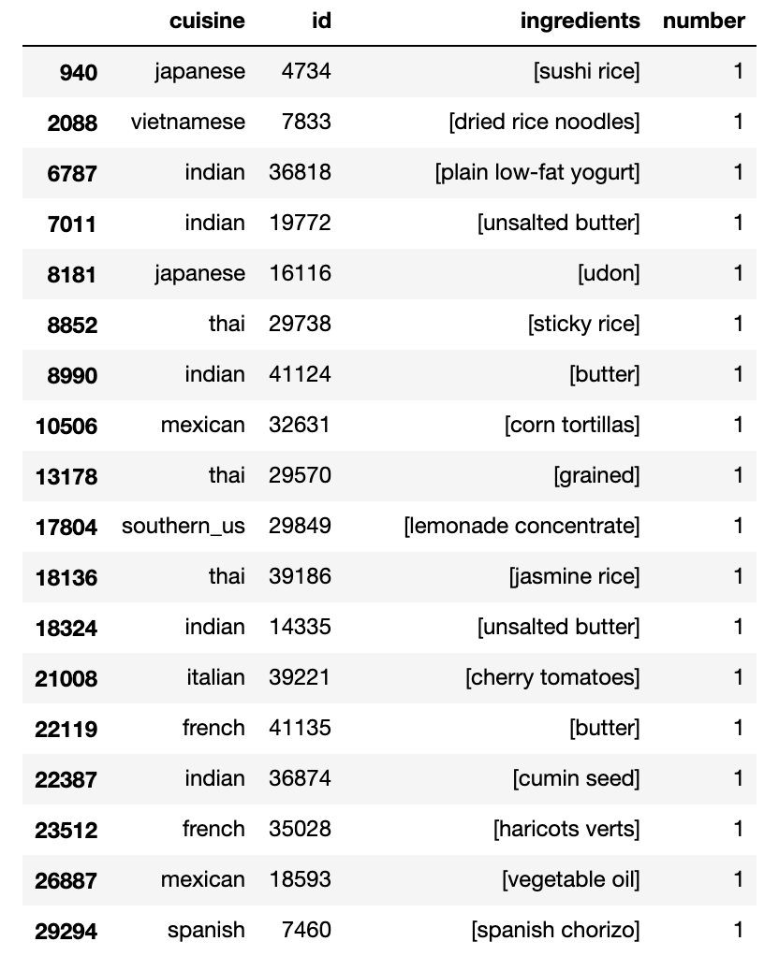
Data Cleaning
Removing 22 one-ingredient recipes
Made decision not to harmonize ingredients, eg:
Yogurt vs. low fat yogurt
Butter vs. unsalted butter
Some of the one-ingredient recipes

Slide 5
Eda

Slide 6
Eda insights
Longest recipe from Italian cuisine (65 ingredients)
Moroccan, Indian, Vietnamese, Cajun and Thai cuisines have the longest recipes. (13 ingredients)
Shortest recipes come from the Brazilian and Irish cuisines (9 Ingredients)

Slide 7


Eda insights – most common ingredients
18.6% | 18.8% | 20.0% | 20.0% | 45.4%

Slide 8
Eda insights
Cuisines with more recipes in the training set do not always have more ingredients representing them.
French cuisine is only 6.65% of the dataset, but has more variability than Indian cuisine (which makes up 7.5%).

Slide 9
eda insights - unique ingredients by cuisine
Notes:
The above plots show us quite a bit about how differentiated the cuisines are, and give us an indication of how easy/hard it will be to predict a cuisine based on its ingredients.
Scales are different!!
* Mexican cuisine is the only one where the unique ingredients (mainly refried beans) are also highly represented across Mexican recipes; refried beans are found in more than 200 Mexican recipes in our dataset. We can expect that refried beans and taco seasoning will play an important role in predicting whether a cuisine is Mexican.
* Cachaca is the next most important predictor for a cuisine, with more than 60 Brazilian recipes calling for this spirit
* Gnocchi is an important unique ingredient for Italian food (unsuprisingly)
* Fenugreek is important and unique to Indian food
* Fermented black-beans is important for Chinese cuisine
* Gochugaru is unique to Korean
* The remaining cuisines may be harder to accurately predict based on ingredient presence, they had fewer recipes with ingredients unique to their style of cooking.

Slide 10
Tf / idf
Corpus: What’s cooking dataset
Document: Each Recipe
Word: Ingredient (unigram)
Data Preparation:
All words converted to lowercase
Removal of punctuation, special characters and measurement units, eg:
(10 oz.) frozen chopped spinach
Assumption:
Ingredients in recipes are made up of 1 word (unigram)
After vectorizing the recipes:
Total number of elements: 762,207

Slide 11
eda insights FROM TF-IDF
Notes:
From the visualizations above we can make the following observations:
* Some of our assumptions from earlier EDA were correct:
* Cachaca is major ingredient in Brazilian recipes
* Tortillas are important in Mexican cuisine
* Some seemingly innocuous ingredients are rated highly by tf-idf:
* Milk in Brazilian food
* Butter for Southern_US
* Flour for British and Russian
* etc.
* Some important words appear in many cuisines:
* Sauce, fish, soy, sesame have strong tf-idf values in Chinese, Japanese, Vietnames, Thai, Filipino and Korean foods.
* Butter flour and sugar are important in both British, French and Irish cuisines.
* Spanish, Italian and Greek are clearly all Mediterranean cusines, all using a combination of oil, garlic, pepper and cheese.
* Moroccan, Indian and Jamaican cuisine rely more heavily on spices.

Slide 12
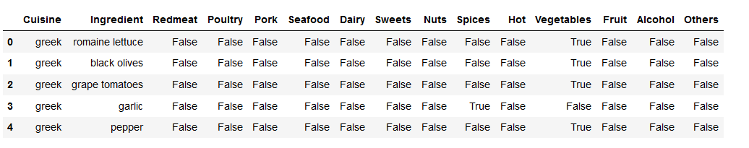
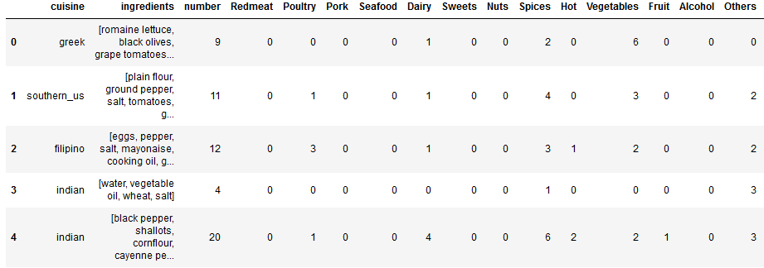
Can we cluster recipes together and find which cuisines are similar? Feature engineering

Slide 13
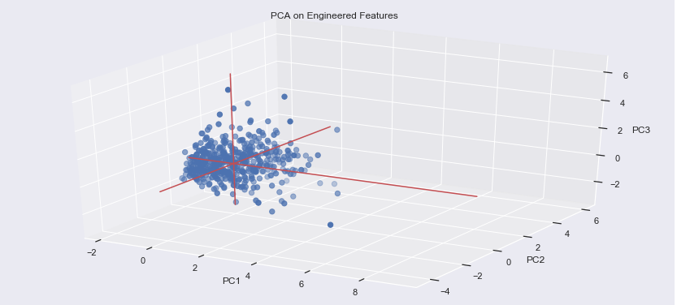

Pca FOR VISUALIZING THE DATA
This is a visualization of only 500 datapoints, nonetheless we can begin to see a very large concentration of data points in one region. Can we really cluster this data?

Slide 14
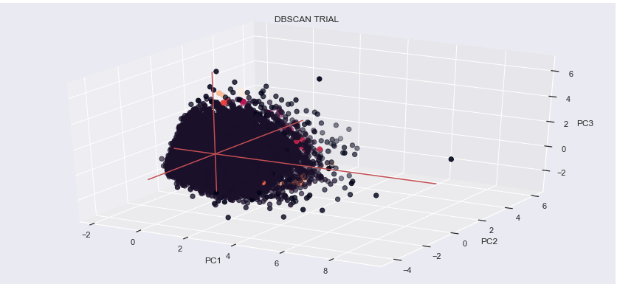
Clusters in db-scan
No configuration of the DB-SCAN parameters separated the points into significant groups to create clusters.
EPS = 0.5 and min_sample = 3 separated the datapoints into 12 clusters, with one cluster having more than 95% of the dataset.

Slide 15
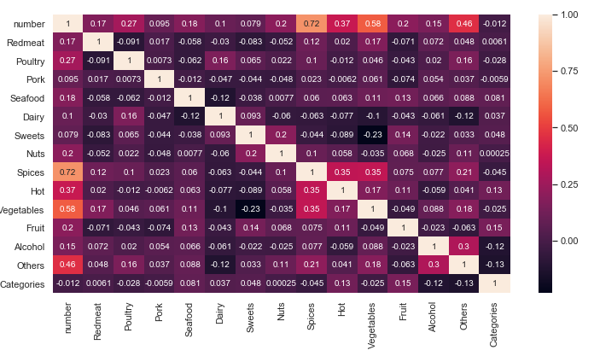
Other findings with engineered features
The high correlation in spices and vegetables with recipe length foretell that the longest recipes have many vegetables and spices.

Slide 16
Machine learning

Slide 17
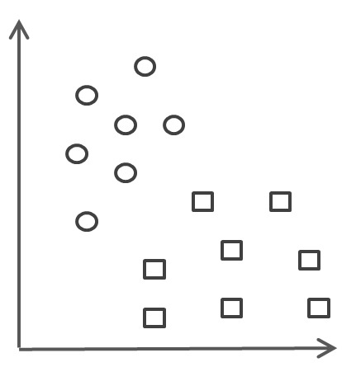
Classification models
LOGISTIC REGRESSION | RANDOM FOREST | SUPPORT VECTOR MACHINE | MULTINOMIAL NAIVE BAYES

Slide 18
A note on unbalanced data
Over-sampling: SMOTE
Under-sampling: Centroid Clustering
Final method:
nothing
Notes:
As we learned during the EDA, the sample data is unbalanced (see counts below). We have a high percentage of Italian recipes relative to all other cuisines. When we first approached ML, we felt that it was necessary to rebalance the data to minimise bias towards Italian recipes and low recall for non-Italian recipes. We believed this was particularly important because we know that Random Forests and SVMs are particularly sensitive to unbalanced data.
We originally applied SMOTE. It creates synthetic (not duplicate) samples of the minority class. Hence making the minority class equal to the majority class. SMOTE does this by selecting similar records and altering that record one column at a time by a random amount within the difference to the neighbouring records. We ran our model training and cross-validation on this adjusted dataset, but it made our dataset too large to manage and created noise. It had a negative impact on the overall accuracy of our models.
Next, to avoid losing potentially useful data, we instead used the Cluster Centroids technique for undersampling. This method undersamples the majority class by replacing a cluster of majority samples This method finds the clusters of majority class with K-mean algorithms. Then it keeps the cluster centroids of the N clusters as the new majority samples. We found that this also resulted in poor accuracy across all algorithms that we attempted.
There is lots of research stating that under- or over-sampling does not necessarily improve model performance. There are specific cases where it can be beneficial, but given the poor accuracies that we found, we concluded that this was not one of those cases. In the end, we decided to proceed with the original unbalanced data.

Slide 19
Key learnings from the ml process
Big Data is hard to work with
Significant time costs
Required to be much more considered in our grid search design / hyper-parameter selection
No guess and check, and difficult to do things simply out of curiosity

Slide 20
Hyperparameters:
C : scipy.stats.expon(scale=1.0)
Notes:
The parameter that we are most interesting in tuning is C, our regularization parameter. We will try a range of C options, from very small (where we increase the regularization strength which will create simpler models that underfit), to very large (where we lower the regularization and increase model complexity).

Slide 21
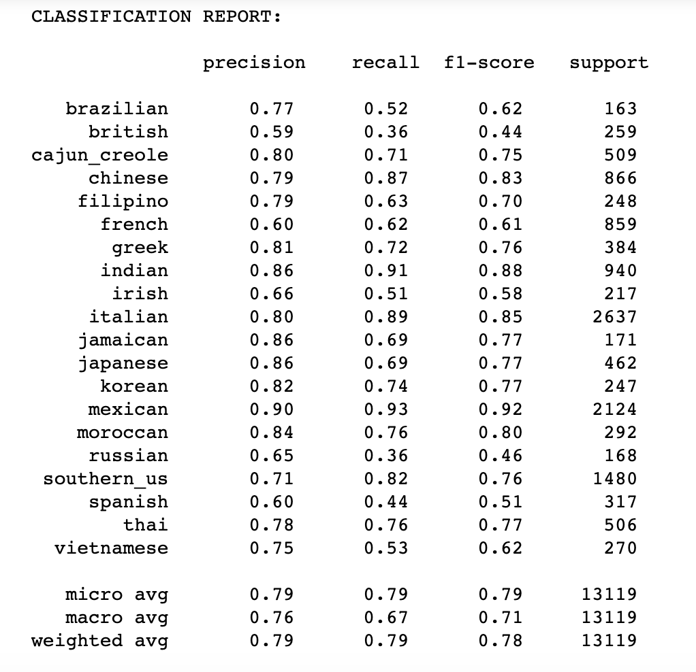
logistic regression
Hyperparameters:
C=3.0417771873834463
Cost:
134 seconds
Accuracy:
78.9%
Findings:
Strong precision for Mexican, Moroccan, Jamaican and Japanese food (EDA confirmed).
Italian recipes are often wrongly predicted to be Mexican or Southern US (diversity of ingredients).
Weaknesses:
Recall, and particularly for Brazilian, British, Irish, Russian and Spanish food.
Type to enter a caption.
Notes:
We can see from the above that our log model has strong precision for Mexican, Moroccan, Jamaican and Japanese food. This makes sense when we remember from our EDA that these cuisines had higher counts of recipes containing ingredients that were totally unique to the cuisine. Recall for Italian food, however, is lower. Italian recipes are often wrongly predicted to be Mexican or Southern_US. This also makes sense when we remember that Italian cuisine had the most diverse set of ingredients.
The biggest flaws for this model are recall, and particularly for Brazilian, British, Irish, Russian and Spanish food; these recipes are all often mis-categorised as something they are not.

Slide 22
Hyperparameters:
bootstrap = [True, False]
max_depth = [10, 30, 50, 70, None]
max_features = ['auto', 'sqrt']
n_estimators = [100,200,500,700]
Notes:
We attempted running the Random Forest grid search with options for all (or almost all) of the possible hyperparameters. This was incredible computationally draining and took hours, so we instead reduced our interest range down to the below four hyperparameters. They provide stopping criteria (max depth and max features), trial different levels of randomness (through bootstrapping options) and also test based on different complexity levels (through n estimators).
**bootstrap:** If we turn off bootstrapping, all of the data is used to fit the model. This means there is no randomness between trees with respect to sampling.
**max_depth:** The deeper the tree, the more splits it has and it captures more information about the data. We'll try a few different options here.
**max_features:** This is another stopping criteria that randomly subsample max features to choose the best one for the split. Auto means all the features are considered, while sqrt means the squareroot of the number of features is considered.
**n_estimators:** This tells the model how many unique decision trees to consider when building our model. We're going to try up to 500 to see how it impacts.

Slide 23
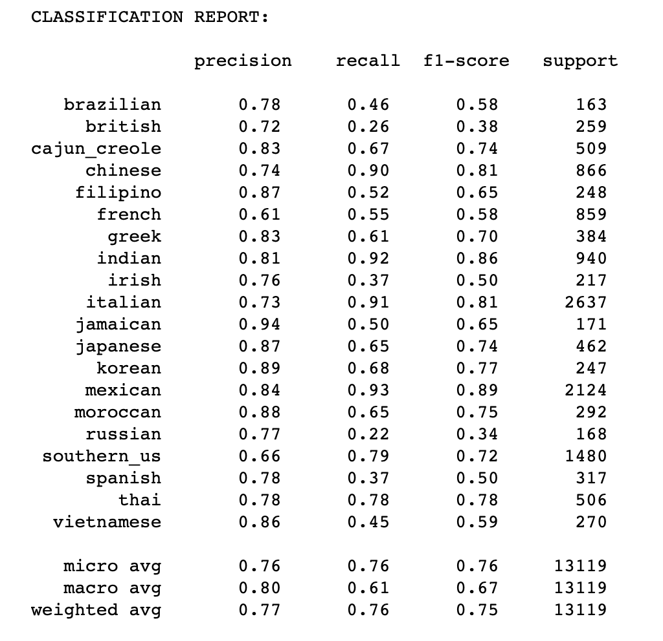
Random forest
Hyperparameters:
n_estimators = 700
max_features = ‘auto’
max_depth = None
Bootstrap = False
Cost:
39,718 seconds
Accuracy:
76.2%
Weaknesses:
Even poorer recall than Logistic Regression
Type to enter a caption.

Slide 24
Models trialled:
OvO
OvR
Hyperparameters:
kernel = ['linear', 'rbf', 'poly', 'sigmoid']
C = [0.01, 0.1, 1, 10, 100]
Notes:
kernel trick: If our data is not linearly separable in our default space, a kernel trick will transform the data into a higher dimensional space where there is a clear dividing margin between classes of data. It seems that the linear kernel is commonly used for text classification. We attempted rbf, but further research showed that it is in fact a poor choice for text classification, plus it is very computationally expensive.
C: The C parameter tells the SVM optimization how much you want to avoid misclassifying each training example. For large values of C, a smaller-margin hyperplane will be used if that hyperplane does a better job of getting all the training points classified correctly. Conversely, for very small values of C our model will look for a larger-margin separating hyperplane, even if that hyperplane misclassifies more points.

Slide 25
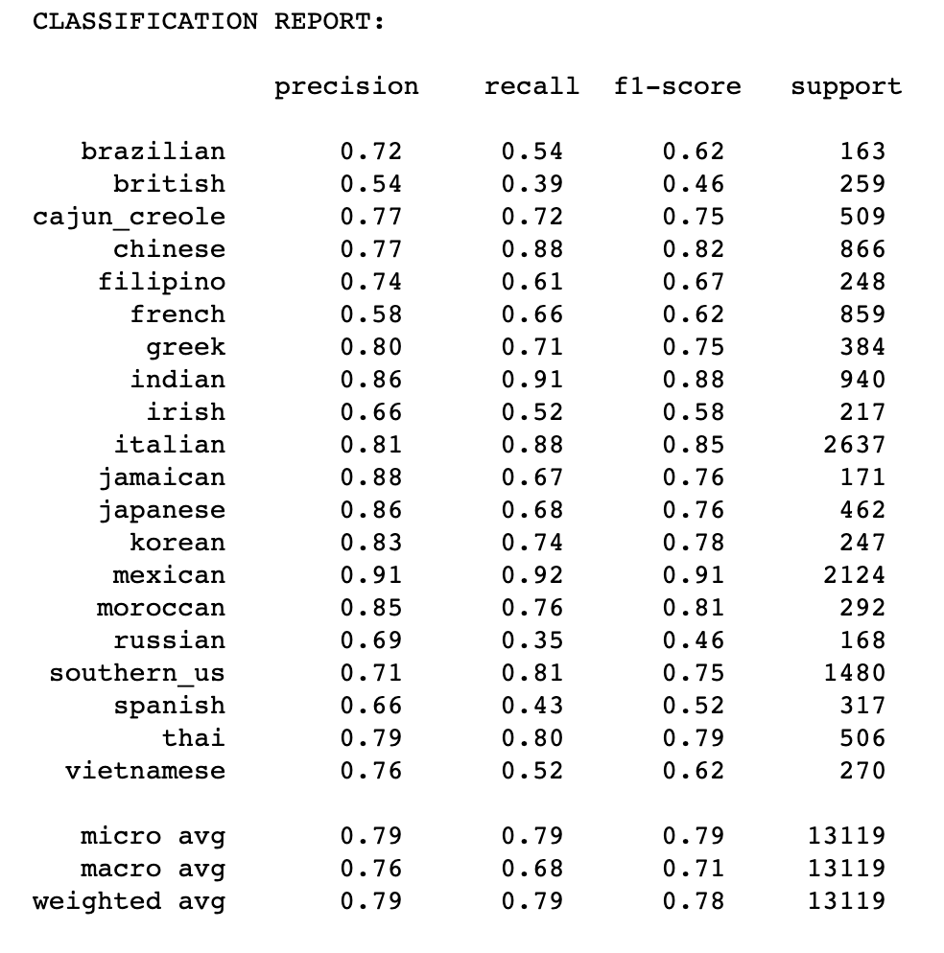
Support vector machine
Hyperparameters:
Kernel = linear
C = 1
Cost:
81,630 seconds
Accuracy:
78.7%
Findings:
The best C value is 1, meaning that our optimizer is moderately sensitive to outliers and does not try too hard to perfectly classify every point.
The best kernel is Linear, and the rbf in fact performed very poorly.
OvO SVM performs marginally better on the test set than our OvR model.
Type to enter a caption.

Slide 26
Input data:
CountVectorized data
Hyperparameters:
alpha = [0.0001, 0.001, 0.01, 0.1, 1]
fit_prior = [True, False]
class_prior = [None, [prior probabilites]]
Notes:
Given that Naive Bayesian model is based on probabilities, it makes more sense to feed a count vector, rather than a tf-df vector. We will therefore apply the CountVectorizer() function to our original data, rather than using the train data we have been using so far.
**alpha:** In this model, alpha refers to the pseudocount that we add to probabilities of bigrams to ensure everything is not zero. The only way for us to really find out the best alpha to set is by iterating over a range of options.
**fit_prior:** This tells our model whether to learn class probabilities or not.
**class_prior:** This tells the model the class_priors to use if fit_prior is True. We set these based on the distribution of cuisines in our original dataset. These prior probabilities were listed at the beginning of the Naive Bayes section.

Slide 27
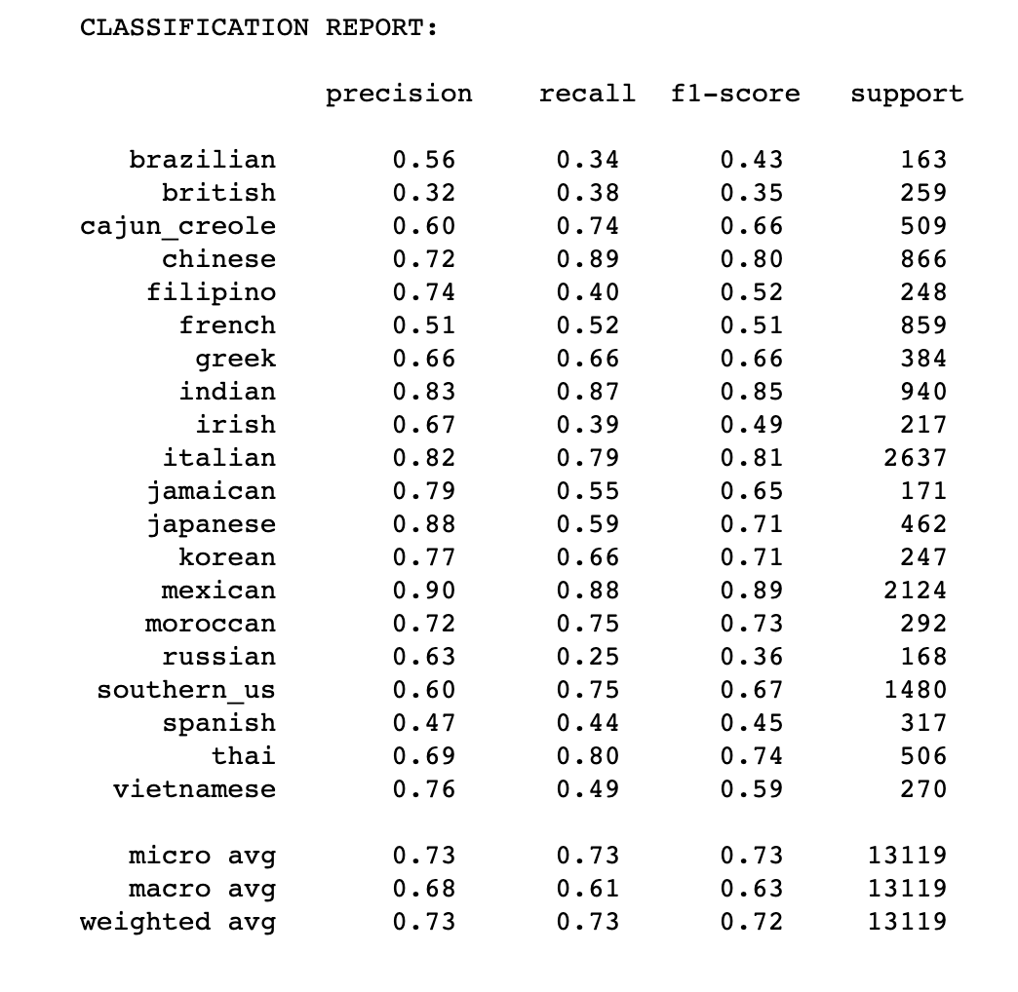
Multinomial naïve bayes
Hyperparameters:
Alpha = 0.01
class_prior = None
fit_prior = True
Cost:
91,454 seconds
Accuracy:
72.7%
Findings:
Although MN is particularly good at predicting categories from text and handling vectorized (sparse) data, the accuracy score was the lowest out of all the best model trials.

Slide 28
conclusions ml

Slide 29
Weaknesses and next steps
Bi-grams and Tri-grams
Neural Nets
Bigger computers to run more comprehensive GridSearch and RandomSearch
Improvement in categories / new expert categories

Slide 30
Appendix

Slide 31
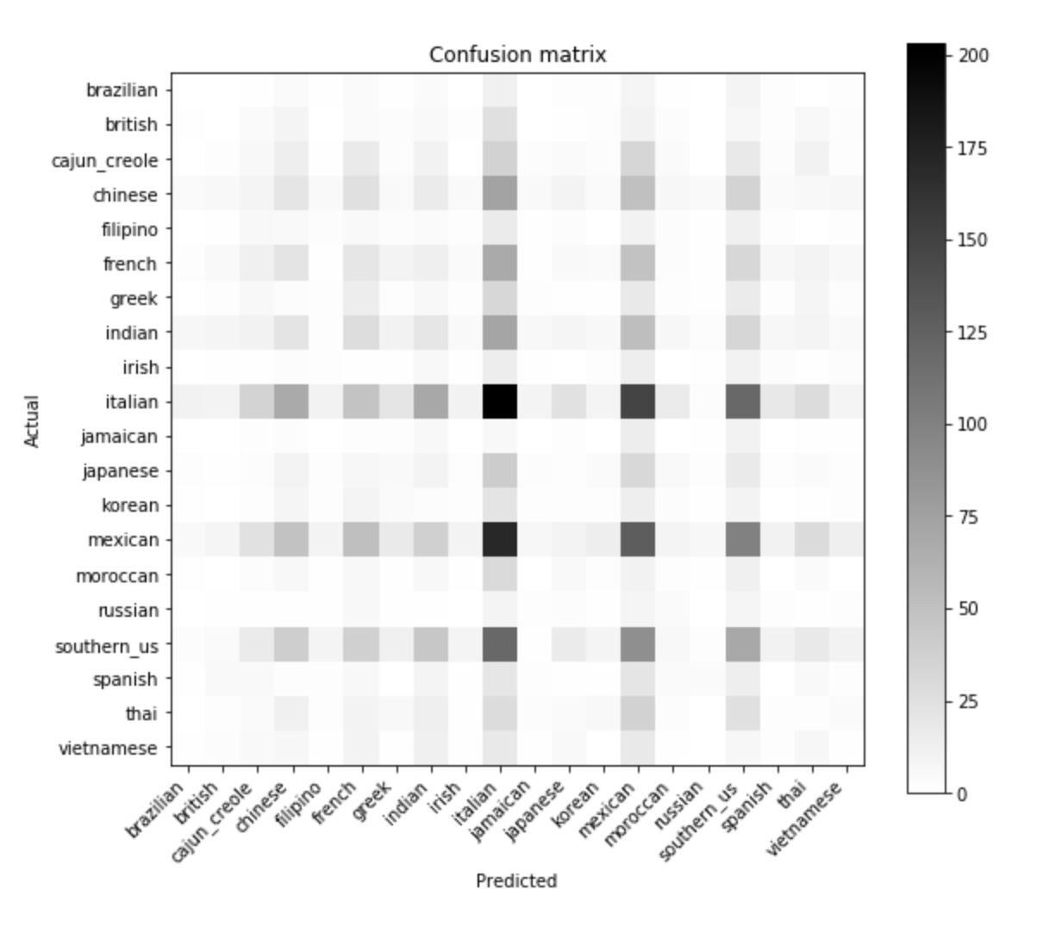
Logistic regression
Type to enter a caption.

Slide 32
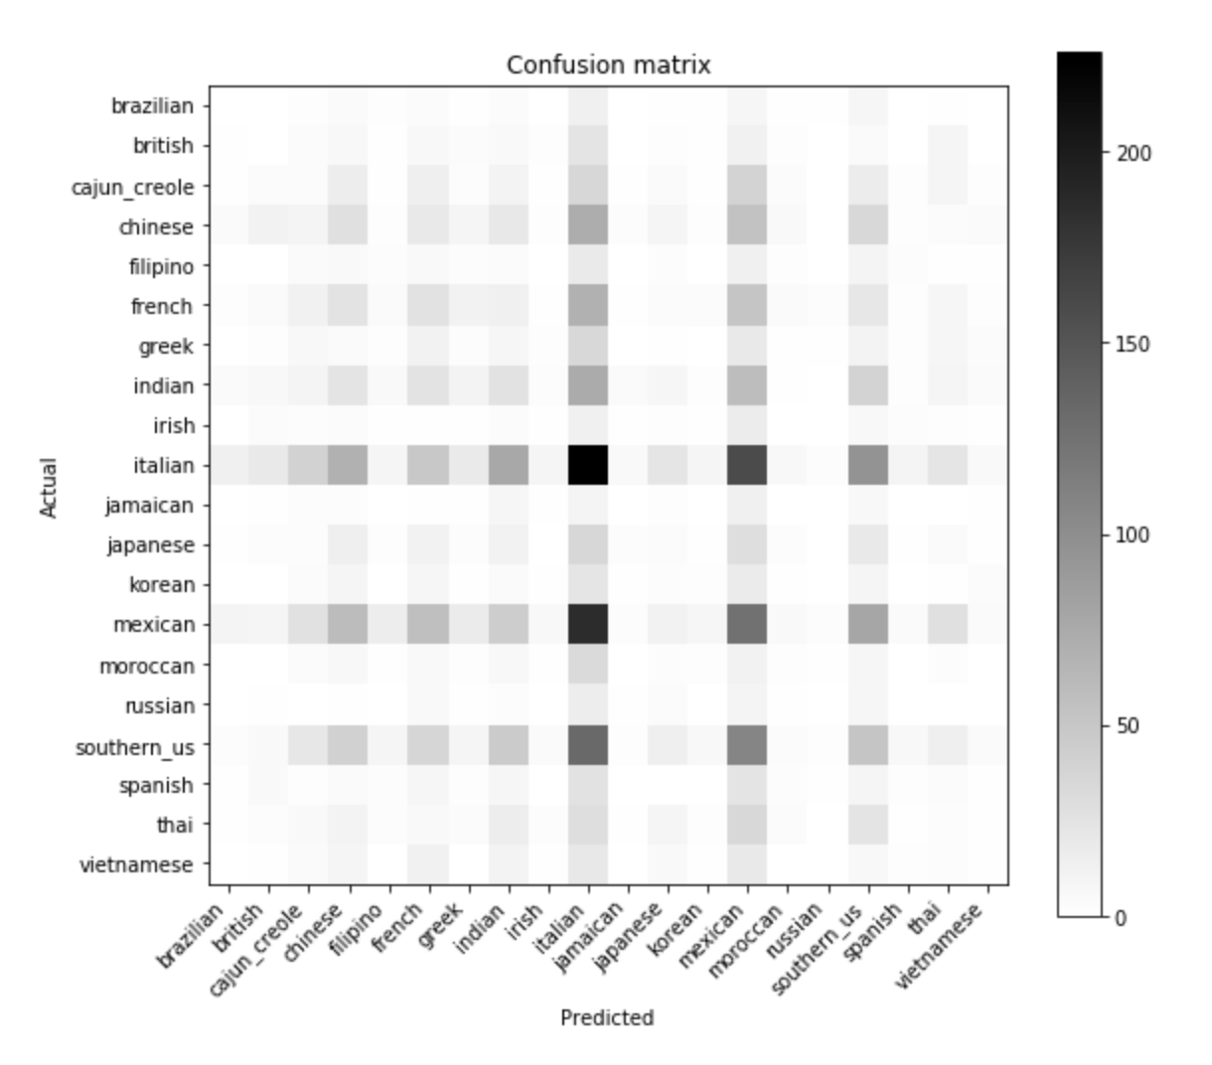
Random forest

Slide 33
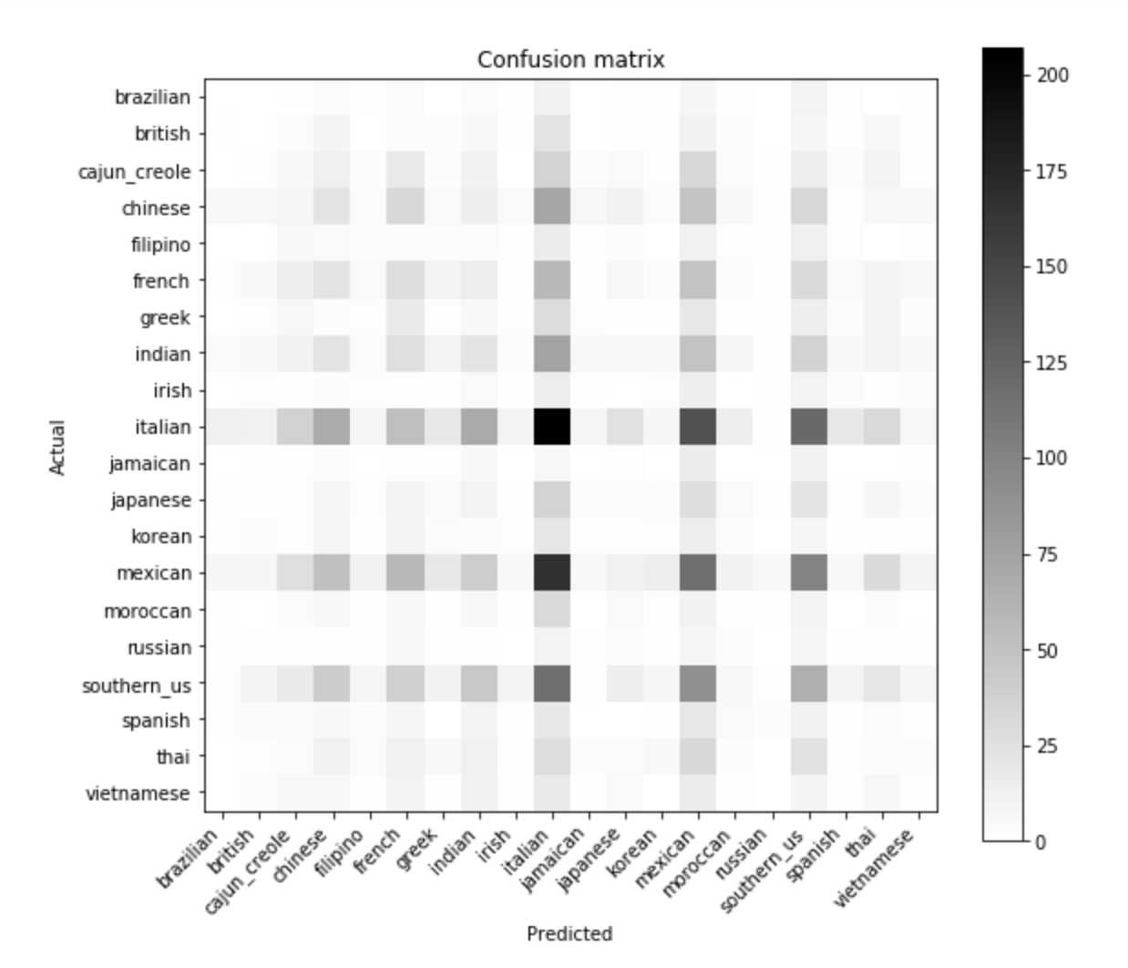
Svm

Slide 34
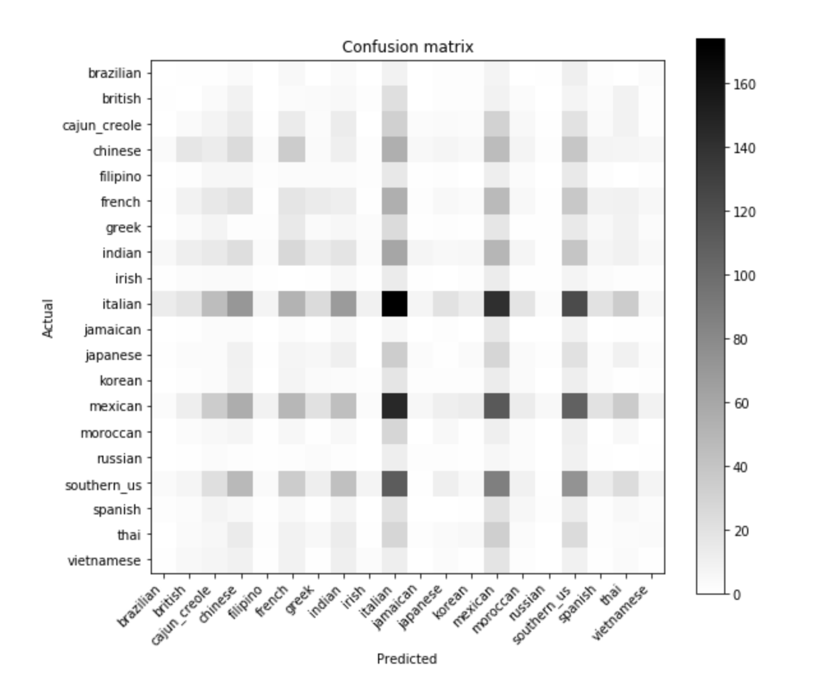
Multinomial nb
Type to enter a caption.

